Slide 1
Recommendation to open a new Indian cuisine restaurant in Toronto Neighborhood.

Slide 2
Coursera capstone Final Project
Introduction
Toronto is the provincial capital of Ontario and the most populous city in Canada. It is also known as an international center of business, finance, arts, tourism, food and culture, and is recognized as one of the most multicultural and cosmopolitan cities in the world. This makes Toronto a place of ample business opportunities including food service industry.

Slide 3
Coursera capstone Final Project
Problem Description
The diverse population of Toronto reflects its current and historical role as an important destination for immigrants to Canada. More than 50 percent of residents belong to a visible minority population group. This diversity is reflected in Toronto's ethnic neighborhoods, which include Chinatown, Corso Italia, Little India, Little Italy, Greektown, Koreatown, Little Jamaica etc. Hence there is a huge opportunity for food service industry to invest. This report will identify and recommend the kind of eatery restaurateurs can establish for a profitable engagement.

Slide 4
Coursera capstone Final Project
Data Description
As we need to explore, segment and cluster the neighborhoods in the city of Toronto, the Toronto neighborhoods data is the key for this project. Neighborhood data is not widely available on the internet in the structured format, hence we need to scrap it through an existing Wikipedia page that has all the required information. We will also like to obtain the key information.

Slide 5
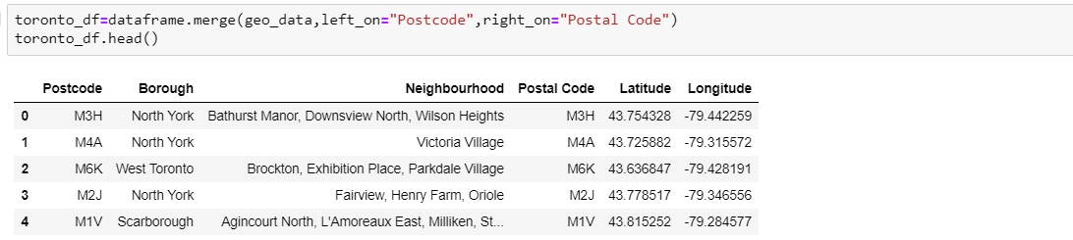
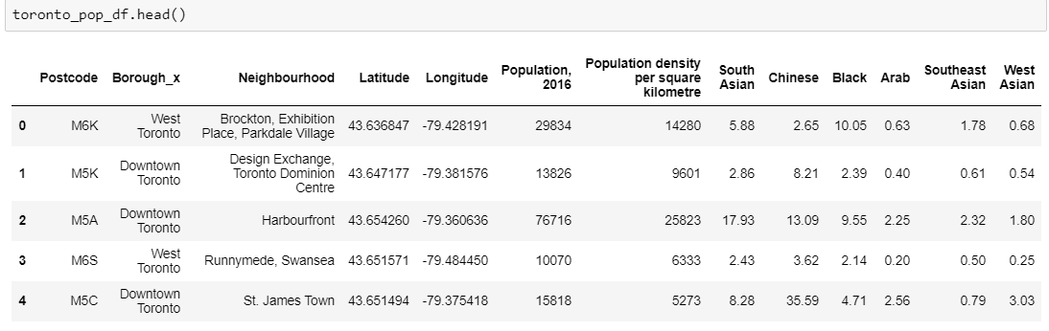
Coursera capstone Final Project
Data Description
Initial data after using web scraping and geocoder.
Added Population data into initial Data.

Slide 6
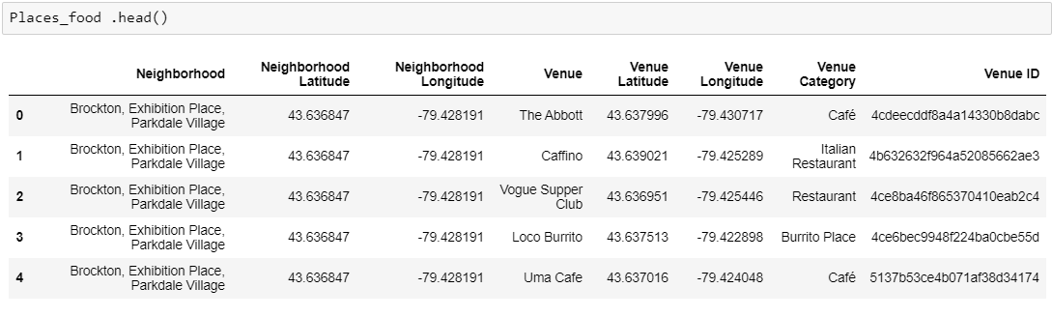
Coursera capstone Final Project
Data Description
The Venue data is another key factor for this project, which is found out by passing the required parameters to the foursquare API and creating another data frame to contain all the venue details along with the respective neighbourhood. .

Slide 7
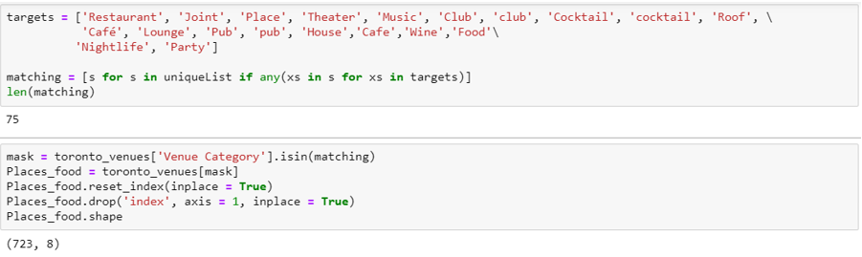
Coursera capstone Final Project
Methodology
Data scrapping from the Wikipedia page that contains the Toronto neighbourhoods has been used and the population data mainly for south Asian people in Toronto neighbourhoods is the key factor for this project.
Furthermore, we need to know the coordinates and locations of this neighbourhoods, and therefore the geocoder API has been used for achieving this objective

Slide 8
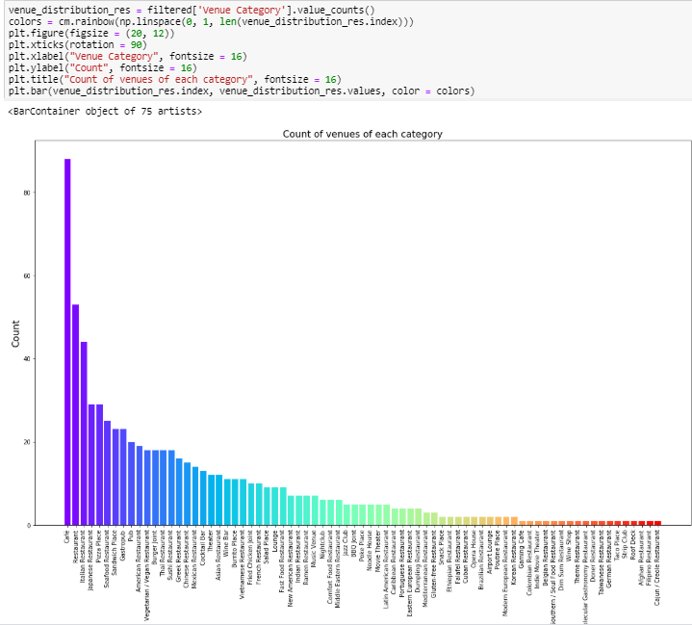
Coursera capstone Final Project
Methodology
After fetching the data for all venues of neighbourhoods, I filtered out the specific venues I was interested in (Restaurants and Nightlife venues).
we can see the filtered venues for restaurants and different food places in Toronto Neighbourhoods.

Slide 9
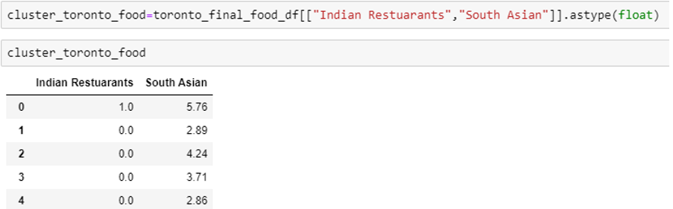
Coursera capstone Final Project
Methodology
This project is specially to find out the place where we can open an Indian restaurant based on the south Asian population in Toronto neighbourhood, so I filter out the venues accordingly.

Slide 10
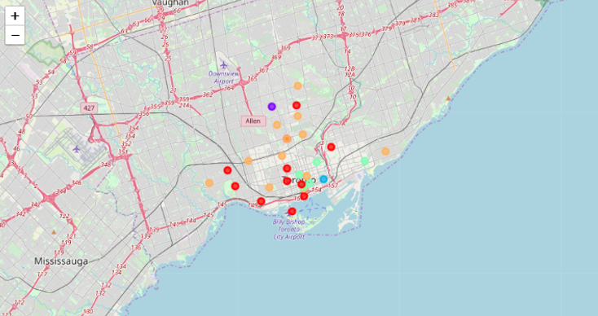
Coursera capstone Final Project
Results
The below cluster shown in light blue are the most ideal spots to open an Indian restaurant.
.
The ideal neighbourhoods for our new location are:
- Harbourfront
- Roselawn

Slide 11
Coursera capstone Final Project
Discussion
We identified that from the total set of venues, majority of them were Cafes. So if a person love particular cuisine (Indian) it is not necessary that he will get it easily.
After picking the best neighbourhood, there’s a lot more work that needs to be done to actually find the best location. However, this project gives a nice start to the process and narrowed down a very long list (from 30 to 2 choices)
The correct set of data is very important for any such projects and mostly it is difficult to find the required data even in the internet.
.

Slide 12
Coursera capstone Final Project
Conclusion
With that, we have concluded that the best recommendation for Indian food industry to first offer their services in Toronto will be Harbourfront and Roselawn with the key factors to consider the high population of south Asians,
It is also recommended to the food industry to re-run this data science program to get the updated result and use the result into consideration as part of the business growth plan in selecting the next neighbourhood to offer their services. This is critical not only to make sure that they got the updated result for better decision making, but also to make sure that they can re-validate the findings from this project. Finally, thank you for the opportunity in this project and we wish you the best success in your business.
.

Slide 13
Thanks

